Slide 1

Shopping Trends & Customer Behavior Analysis Using SQL
Visual Insights from SQL Queries to Drive Marketing, Sales, and Operational Strategy
Created By : Akeira green

Slide 2
🧰 Tools & Dataset Overview
Slide Content:
Dataset: A multi-dimensional dataset capturing customer demographics, purchase behavior, review ratings, seasonal trends, discounts, and operational preferences.
Tools Used:
SQL (MySQL): Used to extract, aggregate, and segment behavioral and transactional data
Excel: Used for building dynamic dashboards with PivotTables, slicers, and custom charts
GitHub: For project version control, documentation, and public portfolio hosting
Deliverables:
Visual dashboards
Stakeholder-ready charts
README documentation
Fully interactive .xlsx file available in the GitHub repo
PowerPoint: To present visual insights in a clean, stakeholder-ready format

Slide 3
🛒 Shopping Trends SQL Analysis Project Overview This presentation showcases visual insights from an in-depth SQL analysis of customer shopping behavior, sales performance, and operational patterns. 🔍 What You'll Find Inside: Customer Behavior: Top 10 high-value customers, frequency trends, review impact Sales Insights: Seasonal revenue, purchase volume, discount/promo effectiveness Operational Patterns: Preferred shipping methods & payment options Marketing Insights: Correlation between satisfaction and spending habits 📈 Each chart is directly tied to SQL queries used in the project, with clear insights and strategic recommendations for stakeholders in sales, marketing, and logistics.

Slide 4
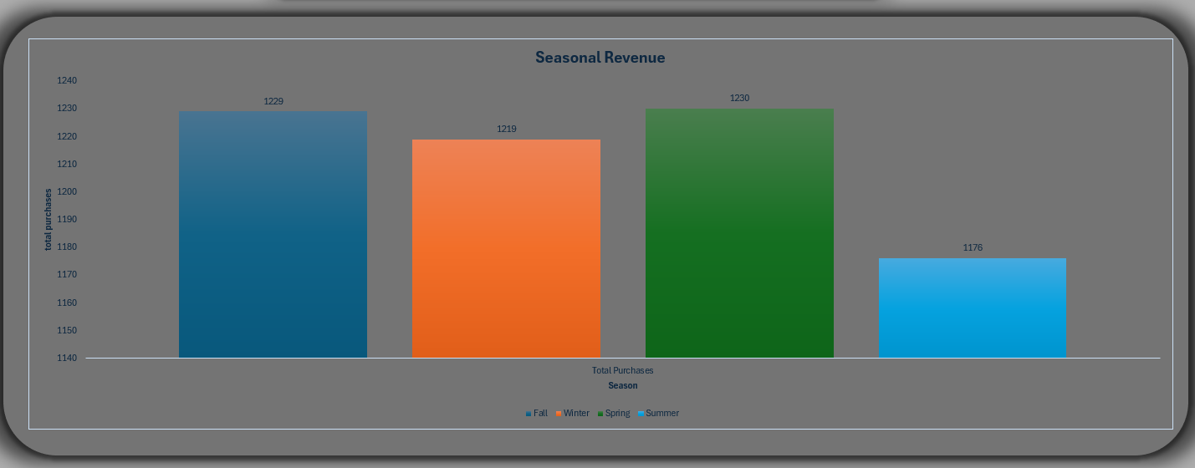
Which seasons generate the most purchases? Fall generated the highest revenue, while Spring had the most purchases. Marketing efforts should be aligned with Fall’s high-value window, while volume-based promotions are better suited for Spring.

Slide 5
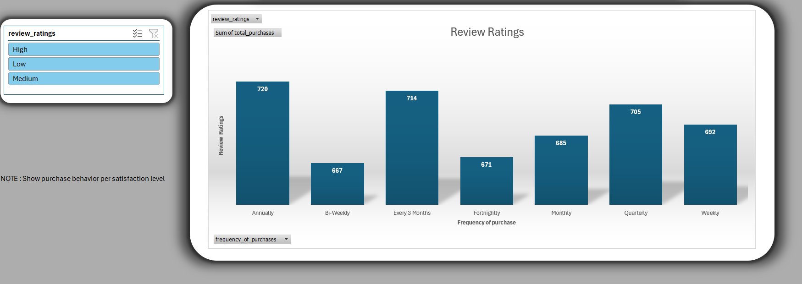
Interactive Excel Dashboard (with Filters) This dashboard brings the SQL analysis to life through Excel’s interactive filters. Users can segment data by shipping type, customer frequency, and payment methods to observe how high-value customers behave. This empowers non-technical stakeholders to explore trends without querying the database.

Slide 6
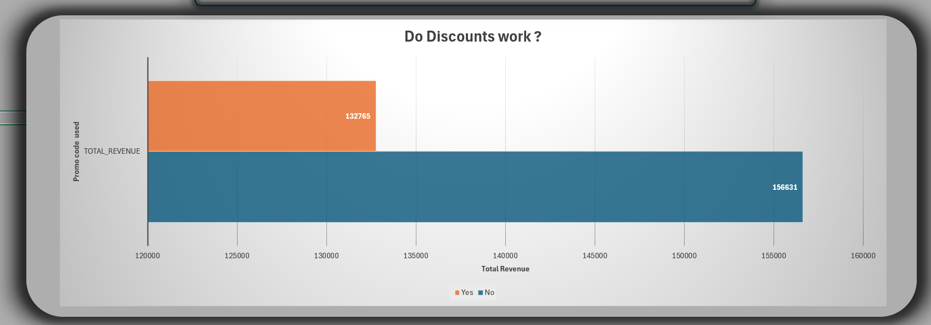
Do discounts and promo codes increase purchases? Promo codes drove fewer total purchases and revenue than discounts alone. This suggests that blanket promo codes may attract low-value, one-time customers — making discount optimization a better strategy.

Slide 7
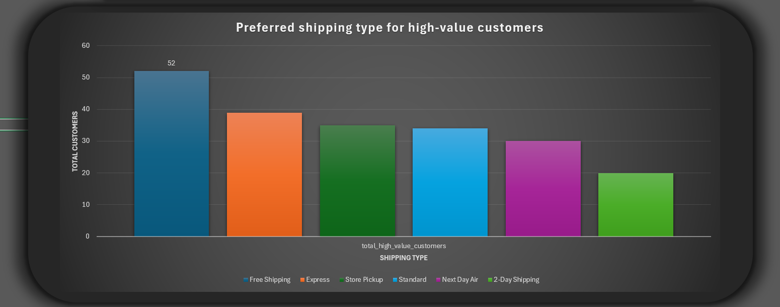
Which shipping type is preferred by high-value customers? Free shipping is overwhelmingly favored by weekly subscribers, while express shipping is second. Loyalty programs should prioritize free shipping to retain top-tier customers.

Slide 8
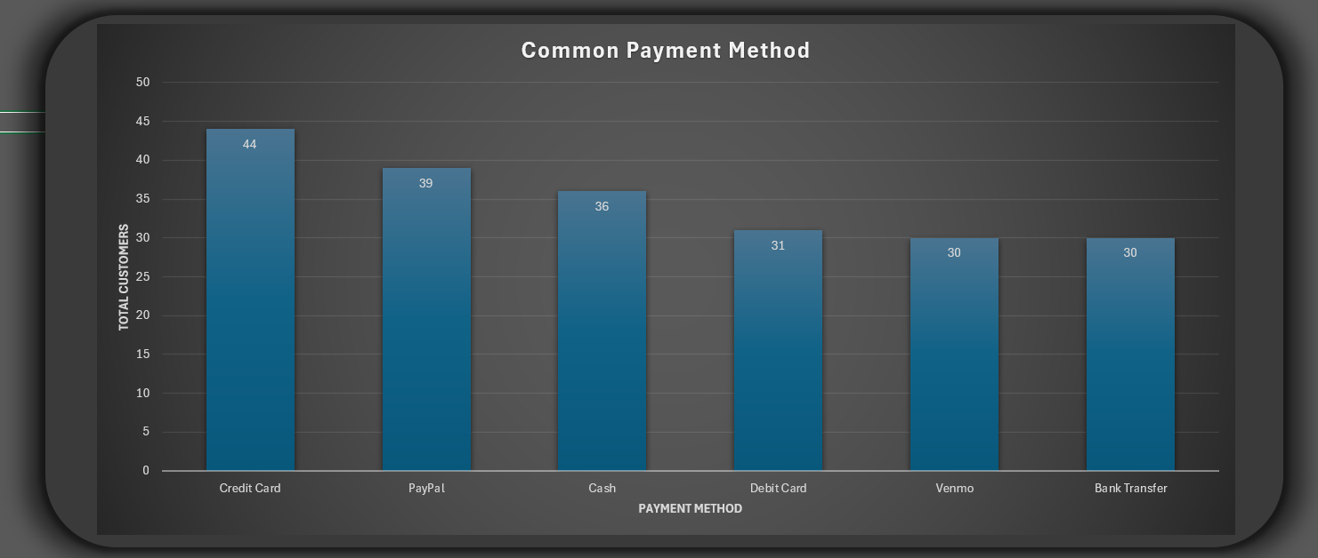
What payment methods are most common among the frequent shoppers? Credit Cards remain the dominant method among frequent shoppers, followed closely by PayPal. Ensuring flexible and secure digital options supports a smooth checkout experience and high conversion rates.

Slide 9
🔚 Conclusion & Next Steps
Slide Content:
Conclusion: Through SQL and Excel-based visualization, this project uncovered actionable insights
about revenue timing, customer satisfaction, loyalty drivers, and purchase behavior. The interactive dashboard provides an intuitive tool for deeper exploration by business teams.
Next Steps:
Expand analysis to include regional or product-level dimensions
Migrate visualizations to Power BI or Tableau for broader BI integration
Implement real-time refresh of SQL data using Excel's external connections
Develop a predictive model to forecast top customer behaviors and churn risk

